Slide 1
Update on the Pathway Project: Feasibility of Using Pharmacoinformatics Methodology
Timothy Mahajan, Project STEM
Malika Mahoui, LRL IT Informatics
Stuart Morton, LRL IT Informatics
Sandra Garces, GPS
Jill Chappell, Clinical Pharmacology
19 July 2017

Slide 2
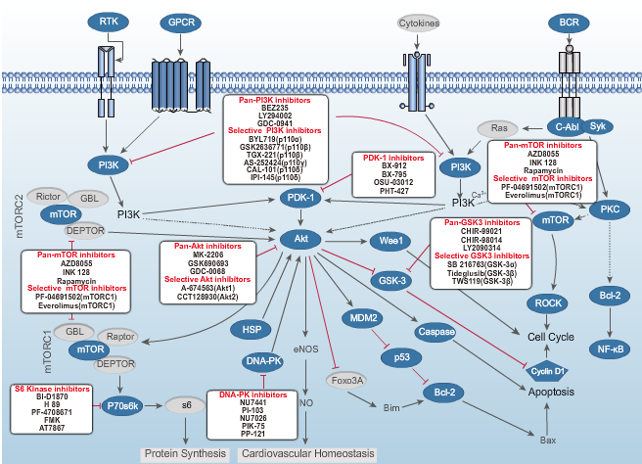
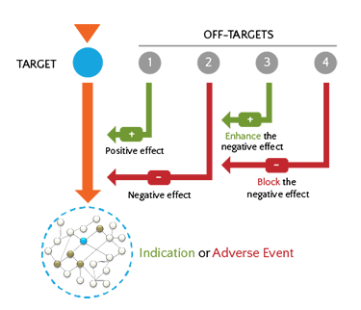
Drug Target Efficacy & Safety Landscapes
Efficacy
Safety
http://www.anaxomics.com/clinical-safety-and-efficacy-profile.php
Notes:
In drug development, ensuring patient safety is crucial and new ways to predict adverse drug reactions are needed.
An adverse drug reaction is a harmful and unintended reaction to a drug that may be considered as ‘on-target’ or ‘off-target.’

Slide 3
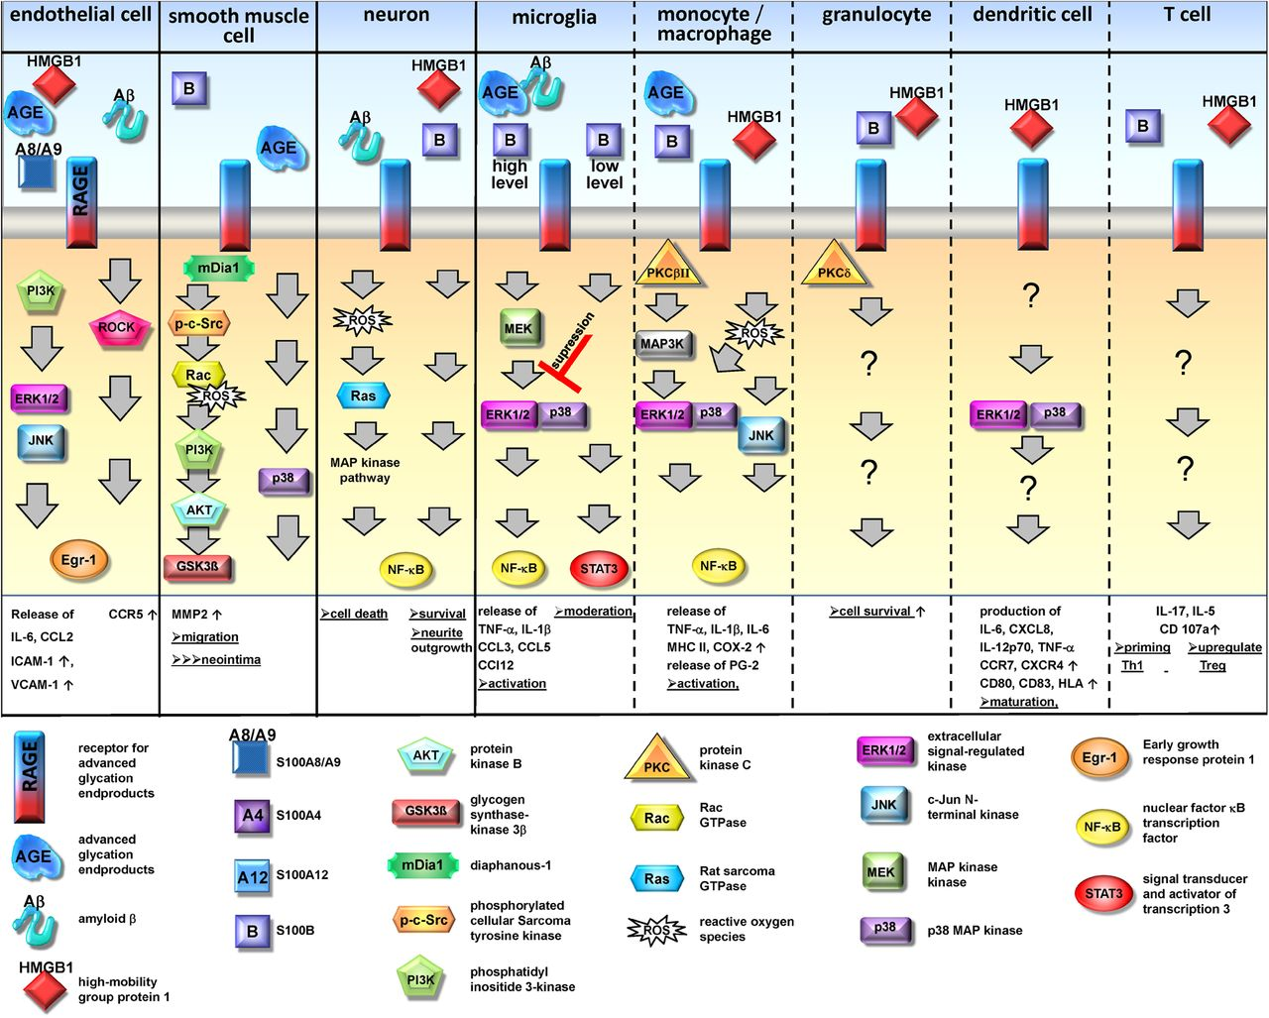
Systems Pharmacology Approach
Drug A
AEs
pathway sequences by tissue
Upstream “Genes”
LY DRUG TARGET
Competitor Drug
AEs
Well-described PATHWAY / “Noodle”
Drug B
AEs
Downstream “Genes”
Drug C
AEs
Adapted from: http://www.jleukbio.org/content/94/1/55.full.pdf+html
Drug D
AEs
NEURO INDICATION
Notes:
A systems pharmacology approach to collate information about proteins in a pathway beyond a known drug target, along with clinical information about adverse effects of drugs known to interact with different proteins in the same pathway, could potentially predict a new drug’s adverse reactions.
(Activation of RAGE is involved in the immediate inflammatory response)

Slide 4
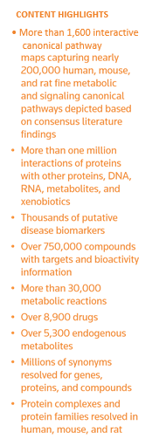
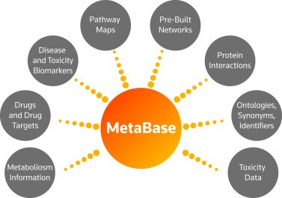
Pharmacoinformatics Methodology
All
Literature
genes (exploratory)
pathways (*noodles)
drugs
AEs
tissues
diseases
Tim’s project
+
OpenVigil interface to FAERs
(AEs)
R Interface
specific queries
MetaBase is a knowledge database manually curated/validated by scientists (Clarivate criteria)

Slide 5
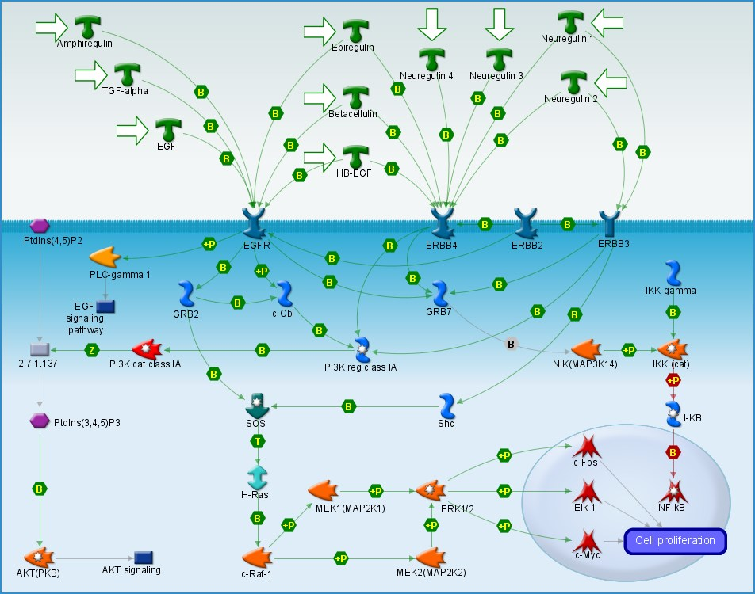
MetaBase Background: Pathway maps
Pathway maps are manually created on the basis of manually curated interactions.
Comprise network objects, interactions between objects and references to other maps.
Organized into the pathway map ontology.
Graphical representation is available for each map
A typical canonical pathway map contains 3-6 signaling pathways describing a particular biological mechanism, (e.g. ERBB-family signaling) (1)
1. THOMSON REUTERS METHODOLOGY, METABASE SCRIPTS LIBRARY 4.2.3 (Tutorial)

Slide 6
Metabase Background: Noodles
Noodles are automatically generated linear sequences of highly curated interactions. They are derived either from pathway maps or curated networks (1).
Noodles represent canonical signaling paths, typically originating from a ligand or another important signaling molecule and ending with transcription regulation event or another downstream molecular response (1).
Noodles are highly redundant;
e.g. A -> B -> C -> X and
A ->B->D->X
are 2 different noodles.
1. THOMSON REUTERS METHODOLOGY, METABASE SCRIPTS LIBRARY 4.2.3 (Tutorial)

Slide 7
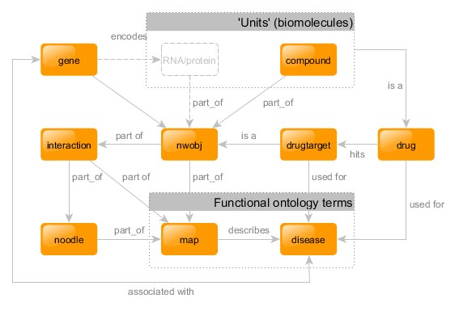
MetaBase terminology accessed through R script
1. THOMSON REUTERS METHODOLOGY, METABASE SCRIPTS LIBRARY 4.2.3 (Tutorial)

Slide 8
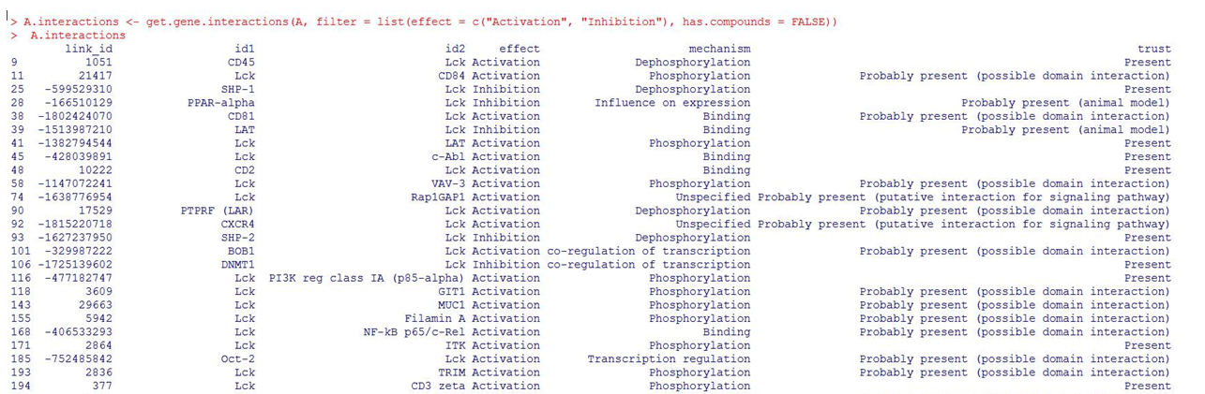
Interaction Screenshot

Slide 9
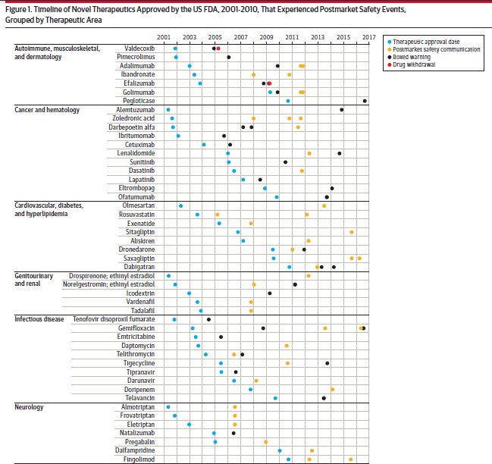
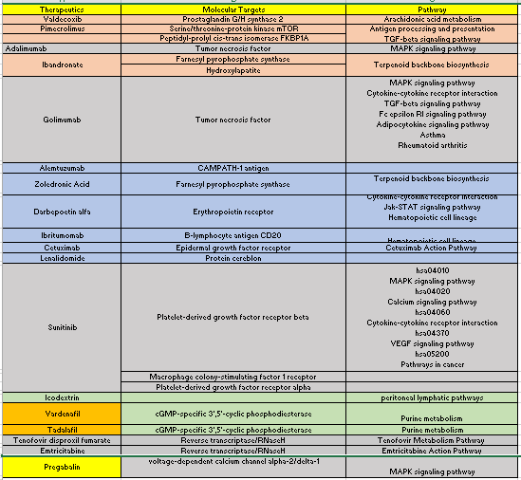
Identification of a Literature-Based Pathway Postmarket Safety Events Among Novel Therapeutics Approved by the US Food and Drug Administration Between 2001 and 2010," Downing et al. (2017)
KEGG, DrugBank
*evaluated 48 drugs
Notes:
In the article, “Postmarket Safety Events Among Novel Therapeutics Approved by the US Food and Drug Administration Between 2001 and 2010," Downing et al. (2017) describe novel therapeutics with significant safety findings identified after drugs were approved, including adalimumab, golimumab, sunitinib, and pregabalin.
Safety Events:
Adalimumab: Boxed warning (Nov ’09): Malignancy Safety communication + Boxed warning (Sept ‘11): Risk of Listeria and Legionella infection
Golimumab: Boxed warning (Nov ’09): Malignancy Safety communication + Boxed warning (Sept ‘11): Risk of Listeria and Legionella infection
Sunitinib: Boxed warning (2010): hepatotoxicity, including death
Pregabalin: REMS (2009): increased risk of suicidal thoughts and behavior
Reference:
Downing NS, Shah ND, Aminawung JA, Pease AM, Zeitoun J, Krumholz HM, Ross JS. Postmarket Safety Events Among Novel Therapeutics Approved by the US Food and Drug Administration Between 2001 and 2010. JAMA. 2017;317(18):1854-1863

Slide 10
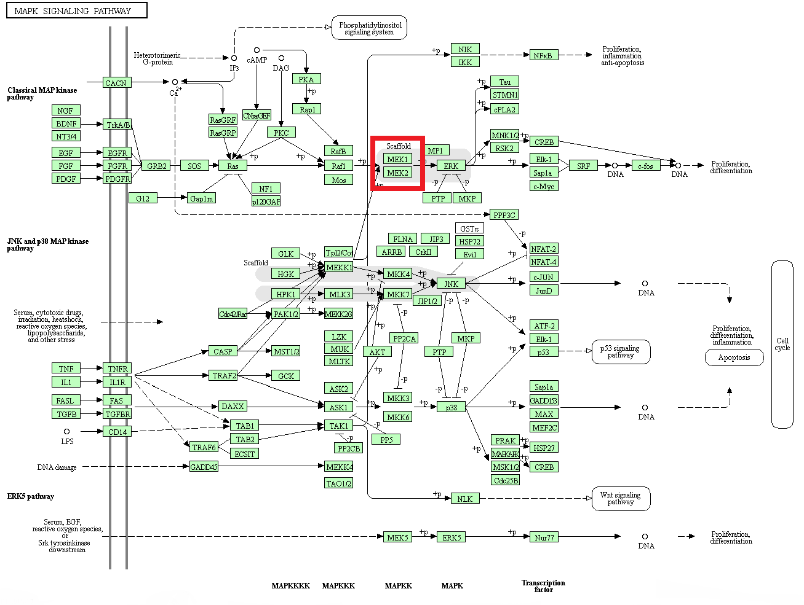
KEGG: MAPK Pathway
Notes:
The 4 selected drugs all act within the MAPK pathway, which has sub-pathways linked by the MEK1 gene so this gene was selected as a proof-of-concept evaluation to test the systems pharmacology pathway approach.

Slide 11
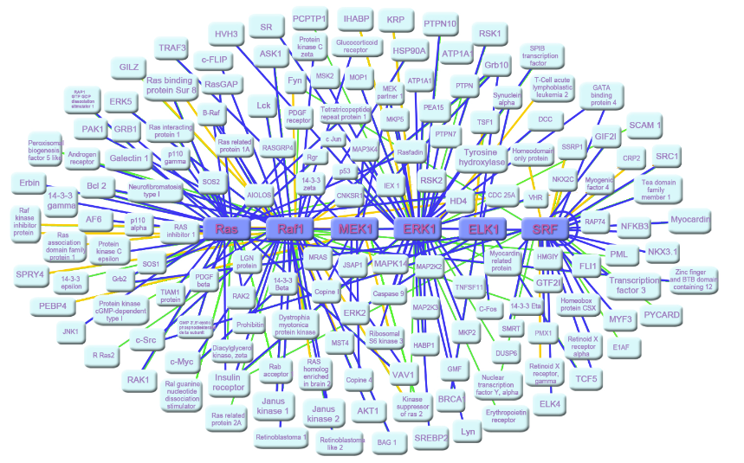
Identifying Genes Related to MEK: An Exploratory Approach
Pros | Cons
Comprehensive | Long Run Time (Using R, but other possibilities exist)
May identify new interactions (possible advantage when categorizing by tissue type) | Requires more user inputs (e.g. definition for parameterized distances )

Slide 12
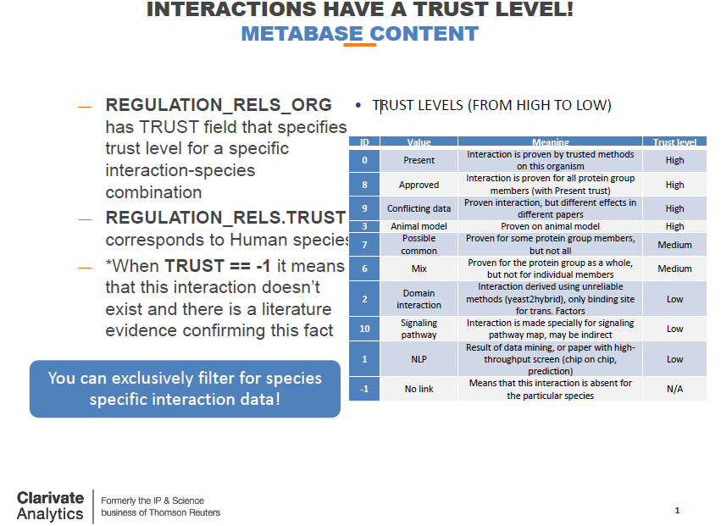

Slide 13
Flowchart of the Pharmacoinformatics Approach
Query Metabase using input Gene
Related Noodle Results
Upstream/ Downstream
Overall Effect
Effect of each interaction
Pathway
Noodle Sequence
User
Metabase
MEK
Query Metabase to find genes in each noodle
Related Drugs Results
Drugs related to each gene in noodle sequence
Activity of Drug (Inh/Act/Sub)
Names of diseases drugs target
Clinical Trial Status
Metabase
Query FAERS using OpenVigil to identify drugs from previous list
FAERS
Adverse Events Results
Drugs related to Gene B
Adverse events of these drugs
Notes:
Objective: Design, develop and test a pharmacoinformatics approach integrating information from several scientific databases, with input from disciplines such as pharmacology and biology to find genes within a parameterized distance of MEK1 and identify drugs that target those and their adverse events.
R, a statistical programming language, was used to mine data from Metacore, an R interface to Metabase, a database of molecular interactions and drugs. This data included genes, their locations relative to one another, the mechanism of reactions between genes, the effect they have on their target organ, and drugs.
FAERS, the FDA’s adverse event reporting system, was used to identify known adverse events of drugs affecting the pathway of interest.
In addition, it was planned to query gene distribution among tissues from Metabase/the Human Protein Atlas but issues arose that could not be resolved in time to complete.

Slide 14
Identification of Noodles
To identify upstream or downstream proteins of MEK in various pathways, the MEK gene was identified as either the start (head) or end (tail) of a sequence of proteins in well-described (high trust) canonical signaling pathways
Gene A | Gene B | Noodle | Pathway Name
MEK1 | Tubulin beta 2B | MEK1--MSX1--Tubulin beta 2B | BMP signaling in embryonic stem cell neural differentiation
MEK1 | Neurogenin 2 | MEK1--MSX1--Neurogenin 2 | BMP signaling in embryonic stem cell neural differentiation
MEK1 | NCAM1 | MEK1--MSX1--NCAM1 | BMP signaling in embryonic stem cell neural differentiation
IL-6 | MEK1 | IL-6--IL-6 receptor--MEK1 | IL-6 signaling in breast cancer cells
GnRH1 | MEK1 | GnRH1--GnRH receptor--MEK1 | Gonadotropin-releasing hormone (GnRH) signaling
Urease B (H. pylori) | MEK1 | Urease B (H. pylori)--CD74--MEK1 | Effect of H. pylori infection on inflammation in gastric epithelial cells
Notes:
Using R, six distinct noodle pathways were identified in Metabase, each having MEK1 as either the Head or Tail of the noodle.

Slide 15
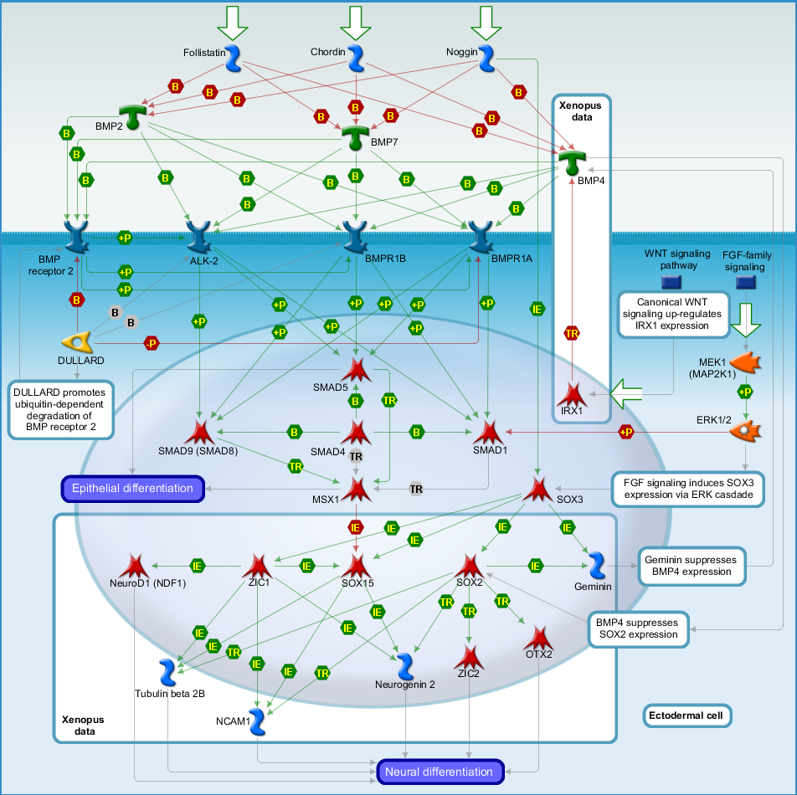
Metabase BMP Signaling Pathway Depicting R-selected Noodles
Notes:
Three distinct noodles were found pertaining to the BMP signaling pathway, therefore this pathway representation in Metabase is shown as an example

Slide 16
Related Drugs
An R script was written to select distinctive genes in the BMP signaling pathway and any FDA approved drugs targeting these genes from Metabase:
Nine distinctive genes SOX15, TUBB2B, MAP2K1, MAPK1, MAPK3, MSX1, SMAD1, NEUROG2, NCAM1 were identified.
Six FDA approved drugs were found to target these nine genes.
Drug Name | Target | Indication | Effect
Eribulin | Tubulin beta-1 chain (in microtubules) | Breast neoplasms | Inhibitor
Estramustine | Tubulin beta-1 chain (in microtubules) | Prostatic neoplasms | Inhibitor
Ixabepilone | Tubulin beta-3 chain (in microtubules) | Breast neoplasms | Inhibitor
Paclitaxel | Tubulin beta-1 chain (in microtubules) | Breast neoplasms | Inhibitor
Vindesine | Tubulin beta-1 chain (in microtubules) | Lung neoplasms | Inhibitor
Vinorelbine | Tubulin beta chain (in microtubules) | Carcinoma, Non-Small-Cell Lung | Inhibitor

Slide 17
Selected Adverse Events Results: Drugs targeting the BMP pathway
Drug Name | Adverse Events (count of reports)
Eribulin | Neutropenia (56) Pyrexia (29) Pneumonia (27) Thrombocytopenia (12)
Estramustine | Dyspnoea (25) Thrombocytopenia (14) Pulmonary embolism (14) Malaise(10)
Ixabepilone | Stomatitis (51) Thrombocytopenia (37) Arthralgia (37) White blood cell count decreased (35)
Paclitaxel | Dyspnoea (1461) Pyrexia (1075) Pneumonia (591) White blood cell count decreased (589)
Vindesine | Thrombocytopenia (15) Pyrexia (14) Pneumonia (12) Hemoglobin decreased (9)
Vinorelbine | Pyrexia (258) Nausea (159) Pneumonia (137) Fatigue (135)
Notes:
Using OpenVigil to access FAERs, the FDA’s Adverse Event Reporting System, the adverse events for the drugs that targeted the genes involved in the BMP Signaling Pathway.
14 adverse events were found for drugs targeting the MAPK and BMP pathways, 11 were found that affected both pathways (Figure 4.)

Slide 18
Selected Adverse Events Results: Drugs targeting the MAPK pathway
Drug Name | Molecular Target | Adverse Events (count of reports)
Adalimumab | Tumor necrosis factor | Arthralgia (4781) Pyrexia (3765) Nausea (3119) Crohn’s Disease (2800)
Golimumab | Tumor necrosis factor | Pneumonia (277) Arthralgia (92) Headache (89) Malaise (60)
Sunitinib | Platelet-derived growth factor receptor beta | Thrombocytopenia (472) Stomatitis (373) White blood cell count decreased (252) Hemoglobin decreased (193)
Pregabalin | Voltage-dependent calcium channel alpha-2/delta-1 | Nausea (2177) Malaise (2062) Fatigue (1947) Dyspnoea (1600)
Notes:
A non-systematic approach was used to select 4 AEs per drug (*not comprehensive)

Slide 19
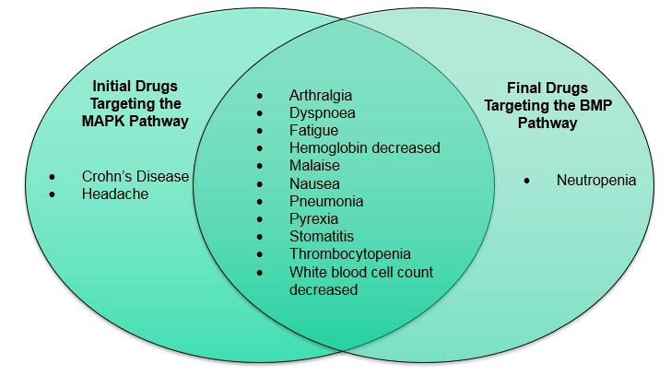
Comparison of Adverse Events of Drugs Targeting Pathways
Eribulin
Estramustine
Ixabepilone
Paclitaxel
Vindesine
Vinorelbine
Adalimumab
Golimumab
Sunitinib
Pregabalin

Slide 20
Conclusions and Next Steps
Multiple adverse events were identified in common for drugs targeting upstream and downstream proteins in the MAPK and BMP pathways.
Differentiating pathways by tissue type may further help to predict the adverse events of a new drug target.
Visual-analytic descriptive techniques can be used to map AEs to a pathway by tissue type

Slide 21
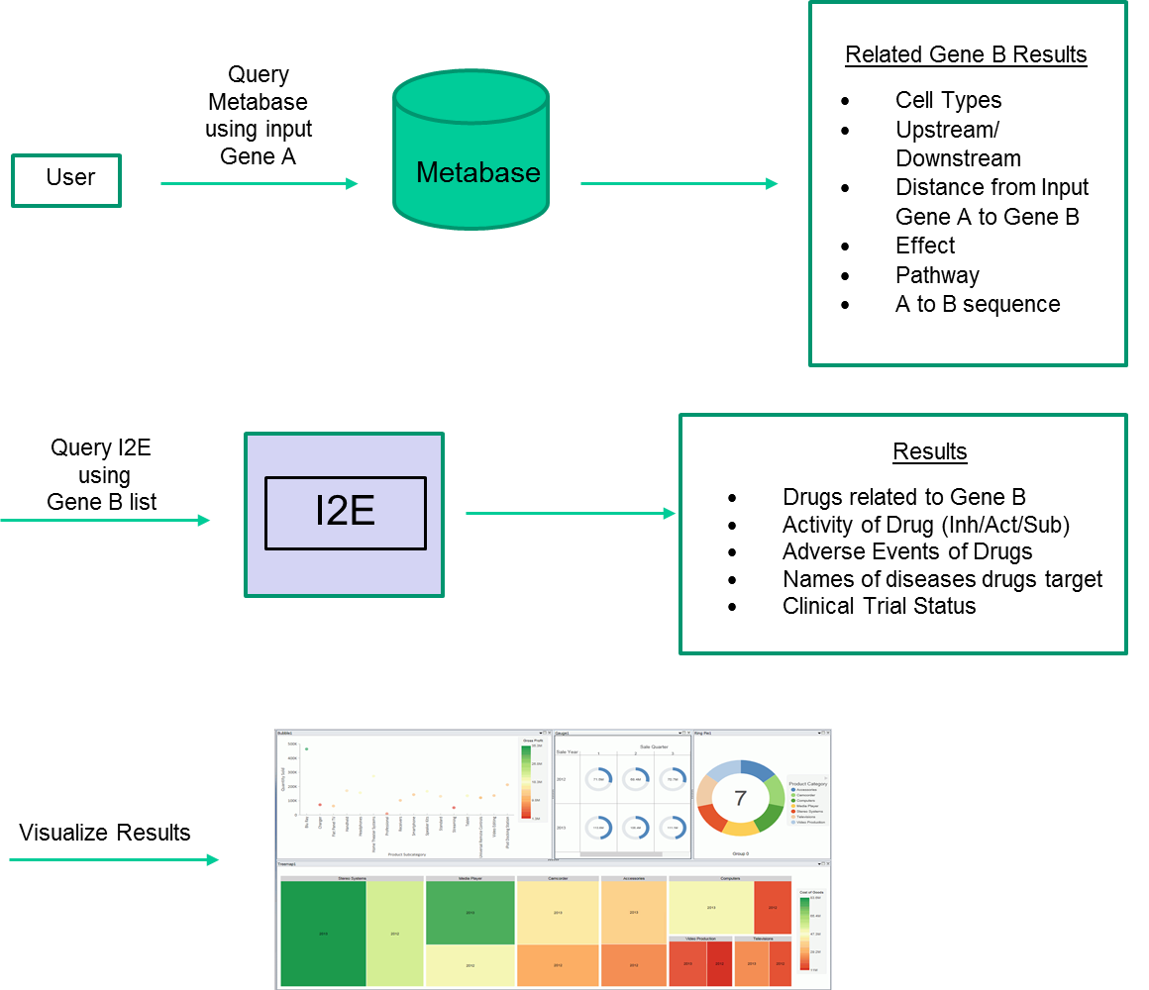
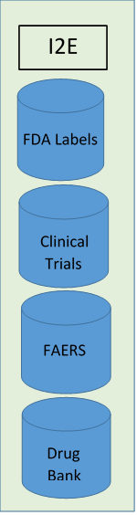
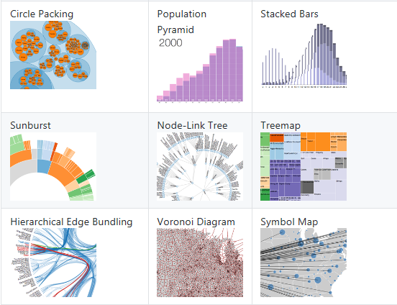
Schematic of Next Steps

Slide 22
Two Examples of Similar Approaches
Anaxomics
ASCPT

Slide 23

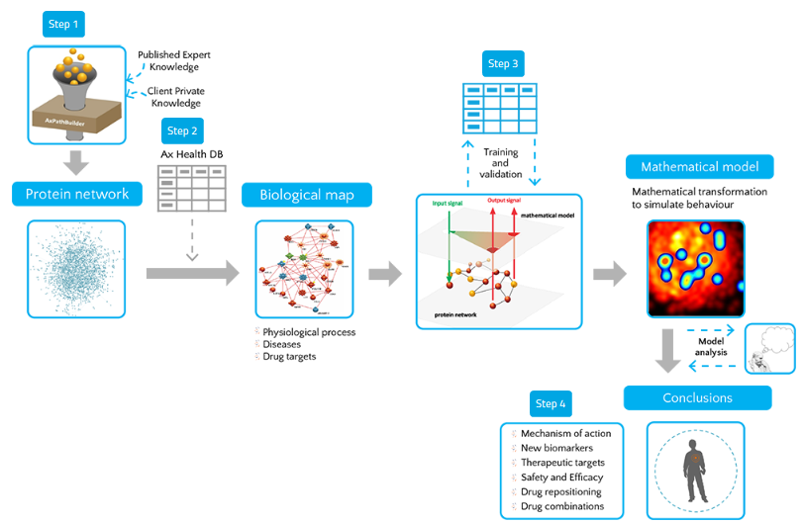
http://www.anaxomics.com/

Slide 24
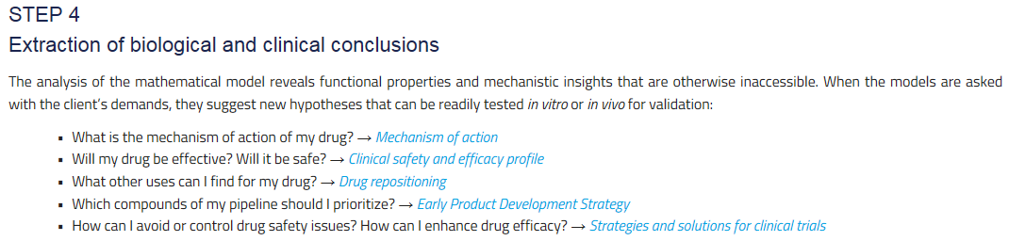
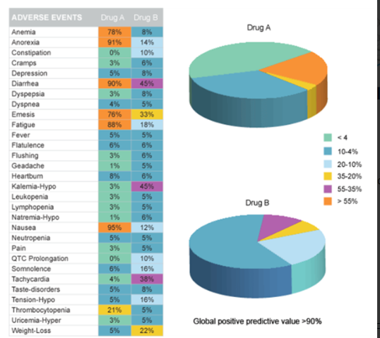

Slide 25
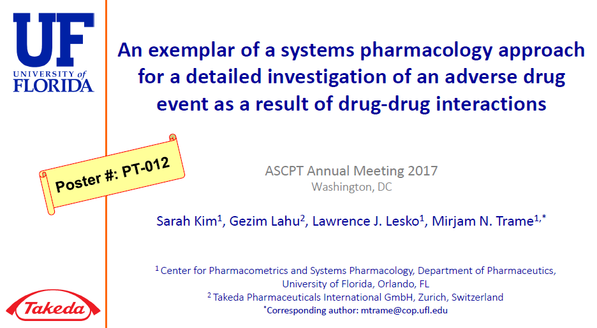

Slide 26
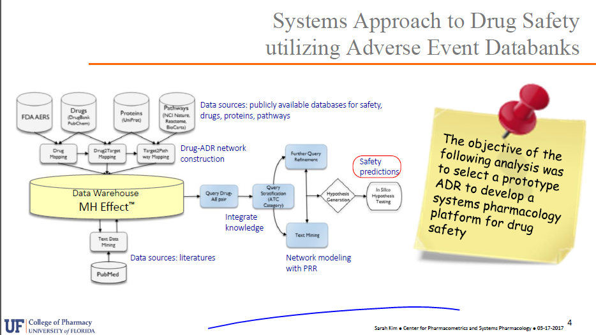

Slide 27
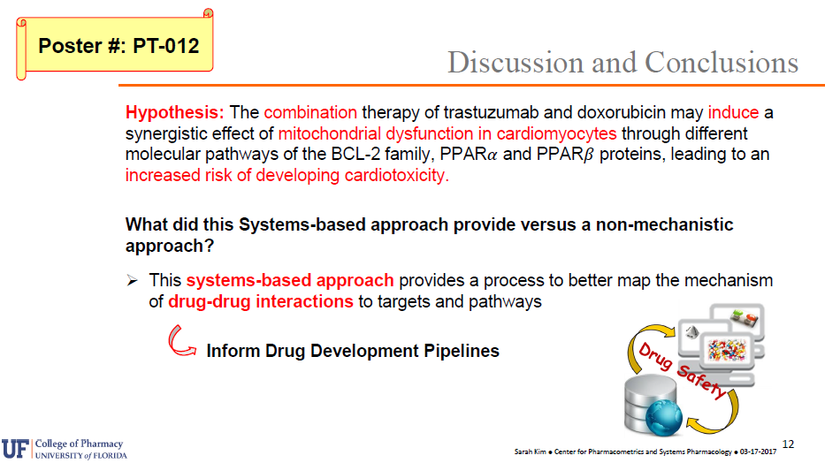

Slide 28
Acknowledgements
Indiana Project STEM and Indiana Clinical and Translational Sciences Institute (CTSI)
Mr. Elmer Sanders, Ms. Charity Scott, Mrs. Shari Harrison, and Mr. Jacob Olsen
Deirdre Kelley and Grace LeFevre
Dr. Paul Ardayfio

Slide 29
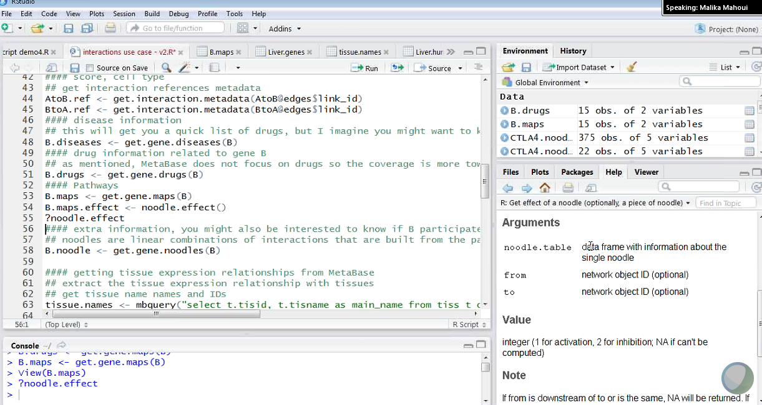
An Example

Slide 30
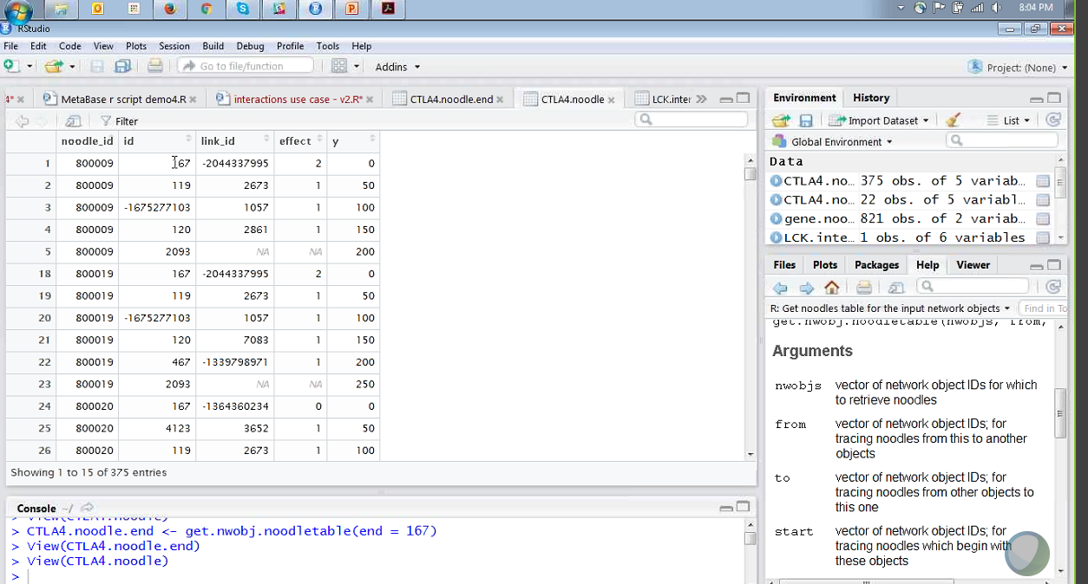
An Example

